Slide 1
Predicting Drug-Target Interaction for New Drugs Using Enhanced Similarity Measures and Super-Target Clustering
Jian-Yu Shi (NWPU)
Siu-Ming Yiu (HKU)
Yiming Li (HKU)
Henry C.M. Leung (HKU)
Francis Y.L. Chin (HKU)

Slide 2
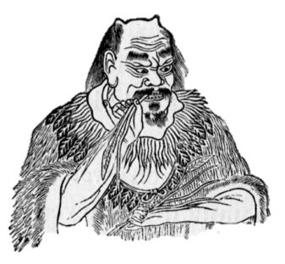
神農
(shen nong; “divine farmer”)

Slide 3
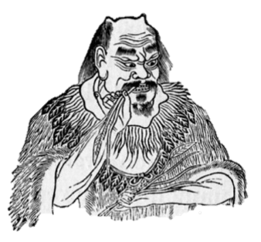
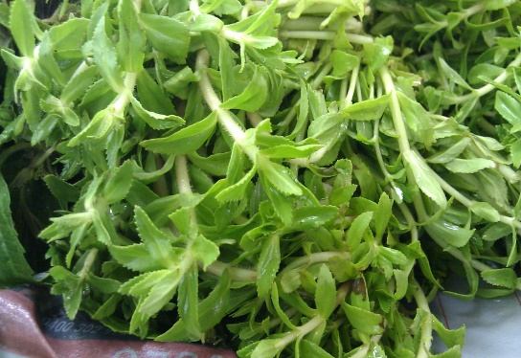
Shen Nong’s Organs
Activity related to
Interaction
Treatment
Herbs
Disease

Slide 4
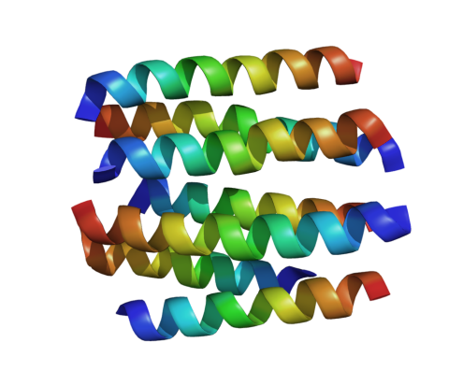
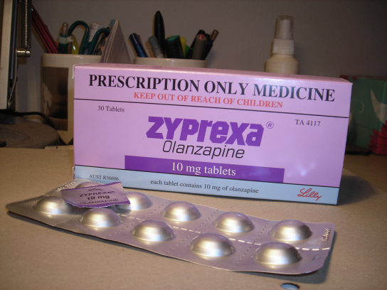

Protein
Activity related to
Interaction
Treatment
Drug
Schizophrenia (a disease)

Slide 5
Drug discovery: Predicting drug-target interaction is the key!
Target
(Protein)
Activity related to
Interaction
Drug
(Chemical compound)
Disease
Treatment
Notes:
Drug targets: The native protein in the body whose activity is modified by a drug resulting in a desirable therapeutic effect.

Slide 6
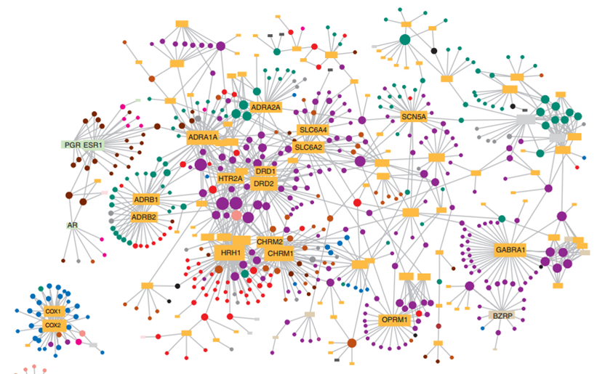
The prediction problem
New drug
New target
Circles: drugs
Rectangles: targets
Edges: interactions
Four scenarios:
Known drug, known target
New drug, known target
Known drug, new target
New drug, new target
* Drug-target network. Yıldırım (2007).
Notes:
Drug-target network (DT network). The DT network is generated by using the known associations between FDA-approved drugs and their target
proteins. Circles and rectangles correspond to drugs and target proteins, respectively. A link is placed between a drug node and a target node if the protein
is a known target of that drug. The area of the drug (protein) node is proportional to the number of targets that the drug has (the number of drugs targeting
the protein). Color codes are given in the legend. Drug nodes (circles) are colored according to their Anatomical Therapeutic Chemical Classification, and the
target proteins (rectangular boxes) are colored according to their cellular component obtained from the Gene Ontology database.

Slide 7
Input
Drug similarity
Target similarity
 | drugs
drugs
 | targets
targets
Drug-target interaction
 | t₁ | t₂ | t₃ | t₄ | t₅
d₁ | 0 | 1 | 0 | 0 | 0
d₂ | 1 | 0 | 1 | 1 | 0
d₃ | 0 | 0 | 1 | 0 | 1
d₄ | 0 | 0 | 0 | 0 | 1
d₁
d₂
d₃
d₄
t₁
t₂
t₃
t₄
t₅

Slide 8
Input
Drug similarity
Target similarity
 | drugs
drugs
 | targets
targets
Drug-target interaction
Train a model for prediction
 | t₁ | t₂ | t₃ | t₄ | t₅
d₁ | 0 | 1 | 0 | 0 | 0
d₂ | 1 | 0 | 1 | 1 | 0
d₃ | 0 | 0 | 1 | 0 | 1
d₄ | 0 | 0 | 0 | 0 | 1
 | t₁ | t₂ | t₃ | t₄ | t₅
d₁ | 0 | 1 | 0 | 0 | 0
d₂ | 1 | 0 | 1 | 1 | 0
d₃ | 0 | 0 | 1 | 0 | 1
d₄ | 0 | 0 | 0 | 0 | 1
Problem with training data:
missing interactions

Slide 9
Existing method #1: WNN-GIP Weighted nearest neighbor – Gaussian interaction profile (PloS One 2013)
Drug-target interaction
 | t₁ | t₂ | t₃ | t₄ | t₅
d₁ | 0 | 1 | 0 | 0 | 0
d₂ | 1 | 0 | 1 | 1 | 0
d₃ | 0 | 0 | 1 | 0 | 1
d₄ | 0 | 0 | 0 | 0 | 1
Biased!
Only uses positive samples to build the model
Notes:
Targets with a lot of missing interactions are unlikely to be predicted to interact with a new drug.

Slide 10
Existing method #2: KBMF2K Kernelized Bayesian matrix factorization (Bioinformatics 2012)
 | t₁ | t₂ | t₃ | t₄ | t₅
d₁
d₂
d₃
d₄
Drug-target
interaction score matrix
Problem with training data:
missing interactions
Drug
similarity
Drug
“latent feature”
Target
“latent feature”
Target
similarity
 | targets
features
 | drugs
drugs
 | features
drugs
 | targets
targets
Hard to explain!
Notes:
Probabilistic model for predicting DTI

Slide 11
Limitations of the existing methods WNN-GIP and KBMF2K
Missing interactions
The similarity measure
Only based on the chemical structure of drugs and protein sequences of targets

Slide 12
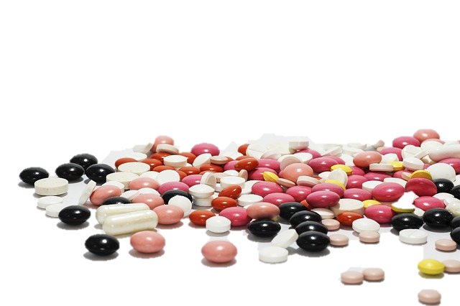
Drug-target interaction prediction as probabilistic events

Slide 13
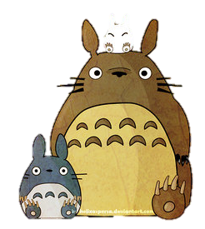
The neighbor idea
A drug’s neighbors: the drugs most similar to it
Predict a new drug’s behavior by its neighbors’ behavior

Slide 14
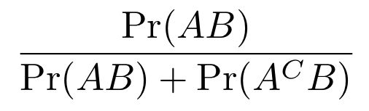
The probability
Event A: to be predicted
(New) drug d interacts with target t
Event B: the observation
# of d’s neighbors interacting with target t
We calculate Pr(A|B) by
Probability of how likely d interacts with t given the observed number of interactions of d’s neighbors with t

Slide 15
“Super-targets”
Our contribution #1

Slide 16
Cluster targets using similarities; Cluster = Super-target
st = super-targets
 | t₁ | t₂ | t₃ | t₄ | t₅
d₁ | 0 | 1 | 0 | 0 | 0
d₂ | 1 | 0 | 1 | 1 | 0
d₃ | 0 | 0 | 1 | 0 | 1
d₄ | 0 | 0 | 0 | 0 | 1
t₁
d₁
t₂
d₂
st₁
t₄
d₃
 | st₁ | st₂
d₁ | 1 | 0
d₂ | 1 | 1
d₃ | 0 | 1
d₄ | 0 | 1
t₃
st₂
d₄
t₅
Notes:
To handle the large amount of missing interactions.

Slide 17
st = super-targets
t₁
d₁
 | st₁ | st₂
d₁ | 1 | 0
d₂ | 1 | 1
d₃ | 0 | 1
d₄ | 0 | 1
sX
t₂
st₁
d₂
t₄
d₃
Aim:
sX: Prob(d₂ interacts with st₁)
t₃
d₂
d₄
st₂
?
t₅
t₂
Notes:
To handle the large amount of missing interactions.

Slide 18
st = super-targets
t₁
d₁
 | st₁ | st₂
d₁ | 1 | 0
d₂ | 1 | 1
d₃ | 0 | 1
d₄ | 0 | 1
sX
t₂
st₁
d₂
t₄
d₃
Aim:
sX: Prob(d₂ interacts with st₁)
t₃
d₂
d₄
If we only use sX, we are assuming all the targets in st₁ are equivalent.
st₂
?
t₅
t₂
Notes:
To handle the large amount of missing interactions.

Slide 19
For new drugs it is the same!
st = super-targets
t₁
d₁
 | st₁ | st₂
d₁ | 1 | 0
d₂ | 1 | 1
d₃ | 0 | 1
d₄ | 0 | 1
sX
t₂
st₁
d₂
sY|X
t₄
d₃
Aim:
sX: Prob(d₂ interacts with st₁)
t₃
d₂
sY|X: Prob(d₂ interacts with t₂ | d₂ interacts with st₁)
d₄
sXsY|X
st₂
?
t₅
sXsY|X: Prob(d₂ interacts with t₂ in st₁)
t₂
Notes:
To handle the large amount of missing interactions.

Slide 20
Cluster targets using similarities; Cluster = Super-target
st = super-targets
 | t₁ | t₂ | t₃ | t₄ | t₅
d₁ | 0 | 1 | 0 | 0 | 0
d₂ | 1 | 0 | 1 | 1 | 0
d₃ | 0 | 0 | 1 | 0 | 1
d₄ | 0 | 0 | 0 | 0 | 1
t₁
d₁
t₂
d₂
st₁
t₄
d₃
t₃
st₂
t₆
d₄
t₅
Notes:
To handle the large amount of missing interactions.

Slide 21
Cluster targets using similarities; Cluster = Super-target
st = super-targets
 | t₁ | t₂ | t₃ | t₄ | t₅
d₁ | 0 | 1 | 0 | 0 | 0
d₂ | 1 | 0 | 1 | 1 | 0
d₃ | 0 | 0 | 1 | 0 | 1
d₄ | 0 | 0 | 0 | 0 | 1
t₁
d₁
t₂
d₂
st₁
t₄
d₃
A new target could be clustered into one of the super-targets
t₃
t₆
d₄
t₅
st₂
For new drugs it is the same!
Notes:
To handle the large amount of missing interactions.

Slide 22
Enhanced similarity measures for drugs and targets
Our contribution #2

Slide 23
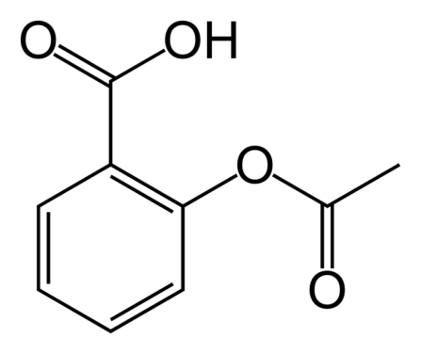
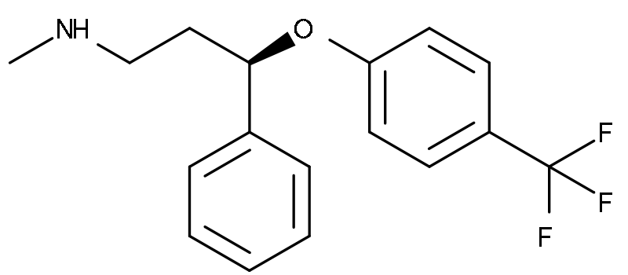
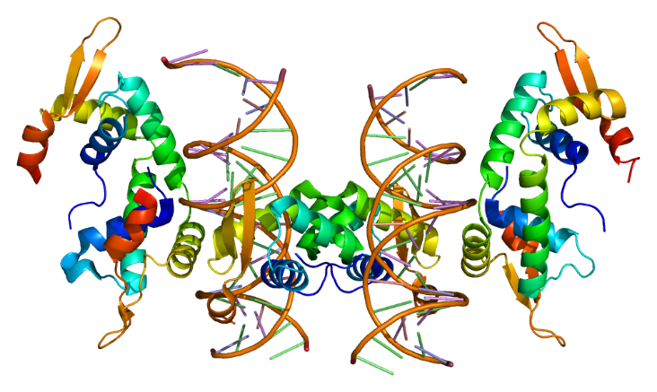
Existing similarity measures
Drugs: aligning the 2D chemical structures
Targets: aligning the protein sequences
Notes:
Drug: (left to right) Aspirin (acetylsalicylic acid), Prozac (Fluoxetine).
Target: Forkhead box protein P2.
Smith-Waterman alignment score

Slide 24
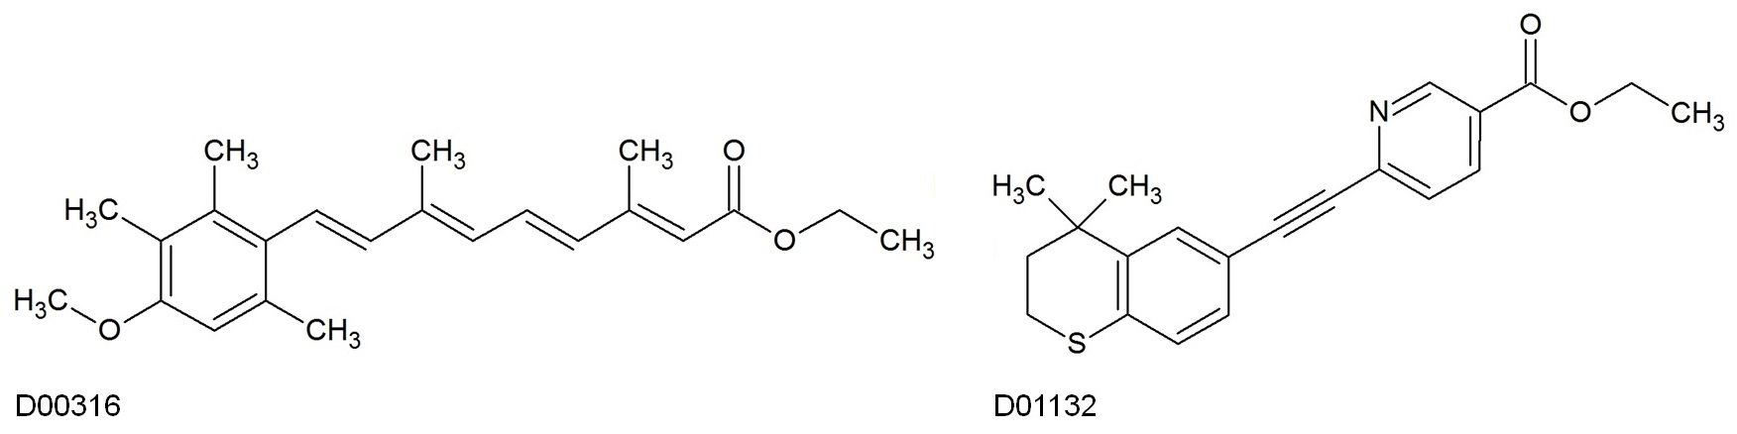
They have low structural similarity (0.275)
but share many targets
* 2D chemical structures extracted from KEGG.
Notes:
One example is the drugs D00316 and D01132. They share many targets but their 2D chemical structural similarity is only 0.275 which ranks 10 out of the most similar 25 drugs to D01132. This implies that structural similarity alone cannot fully capture the characteristics of drugs affecting DTI.
In the NR dataset. D00316 interacts with 6 targets

Slide 25
They have low structural similarity (0.275)
but share many targets
Non-structural similarity measures are needed!
* 2D chemical structures extracted from KEGG.
Notes:
One example is the drugs D00316 and D01132. They share many targets but their 2D chemical structural similarity is only 0.275 which ranks 10 out of the most similar 25 drugs to D01132. This implies that structural similarity alone cannot fully capture the characteristics of drugs affecting DTI.
In the NR dataset. D00316 interacts with 6 targets

Slide 26
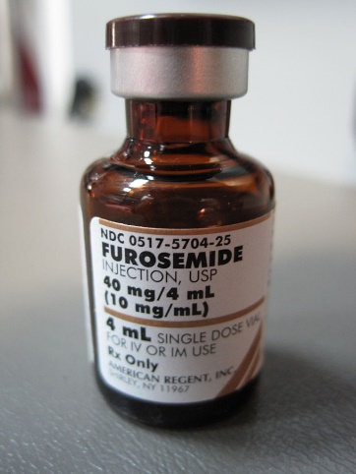
Anatomical Therapeutic Chemical Classification System
C03CA01
Hierarchical
Furosemide
Level 5: chemical substance
Level 4: therapeutic subgroup
Level 3: therapeutic subgroup
Level 2: therapeutic main group
Level 1: organ or system it acts on
Notes:
The ATC system divides drugs into different groups according to the organ or system on which they act as well as their chemical, pharmacological and therapeutic properties.
// A drug can have multiple ATC codes.
Furosemide, a 'water pill,' is used to reduce the swelling and fluid retention caused by various medical problems, including heart or liver disease. It is also used to treat high blood pressure. It causes the kidneys to get rid of unneeded water and salt from the body into the urine.

Slide 27
Anatomical Therapeutic Chemical Classification System
D 05 B B 01
D 05 A X 05
structural similarity
First two levels are the same!
ATC code similarity = 2/5 = 0.4 > 0.275

Slide 28
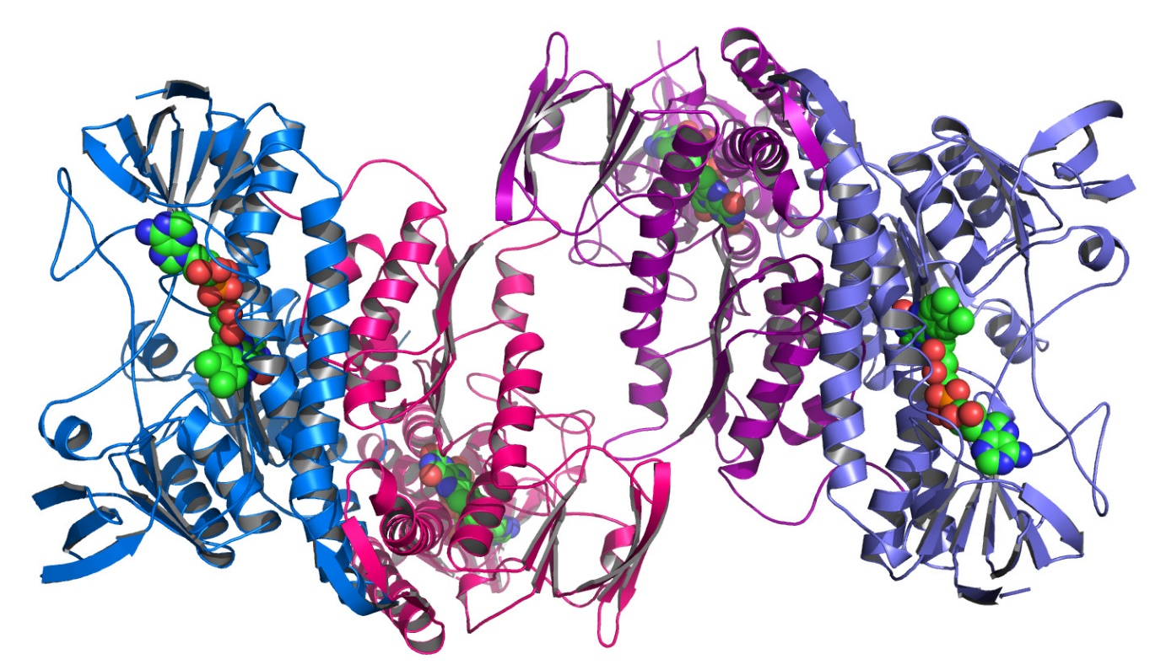
Functional categories of proteins
Non-structural
Describing their functions
Notes:
FC of targets : the classified chemical reactions catalyzed by targets or the annotating functions of protein-coding genes.

Slide 29
Our new similarity measure
Drugs
2D chemical structure similarity
ATC code similarity
2
Targets
protein
sequence similarity
functional category code similarity
2

Slide 30
Our performance
Using new similarity measures and “super-targets”

Slide 31
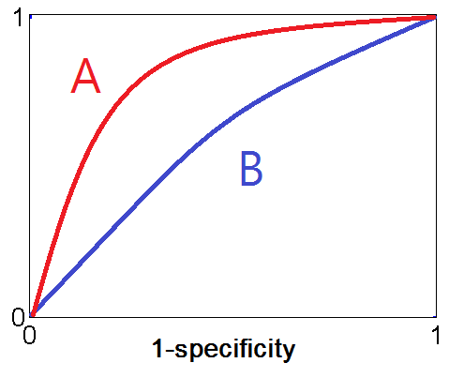
AUC AUPR
A is better than B
TP/(TP+FN)
TP/(TP+FN)
FP/(FP+TN)
TP/(TP+FP)
 | Actual +ve | Actual -ve
Predicted +ve | TP | FP
Predicted -ve | FP | TN
 | Actual +ve | Actual -ve
Predicted +ve | TP | FP
Predicted -ve | FN | TN

Slide 32
AUC AUPR
A is better than B
TP/(TP+FN)
TP/(TP+FN)
Missing interactions:
Much more negative samples
FP/(FP+TN)
TP/(TP+FP)
 | Actual +ve | Actual -ve
Predicted +ve | TP | FP
Predicted -ve | FP | TN
 | Actual +ve | Actual -ve
Predicted +ve | TP | FP
Predicted -ve | FN | TN
When # of FP’s is big:
AUC is overly optimistic
Notes:
1-specificity is just the false positive rate
The class distribution in our data set is largely skewed. We have a much larger number of negative examples due to the missing interactions.
Therefore, a large change in the number of false positives could result in a very small change in the false positive rate used in AUC.
The AUC could be overly optimistic.
AUPR better captures the effect of the large number of negative examples on the algorithm’s performance.

Slide 33
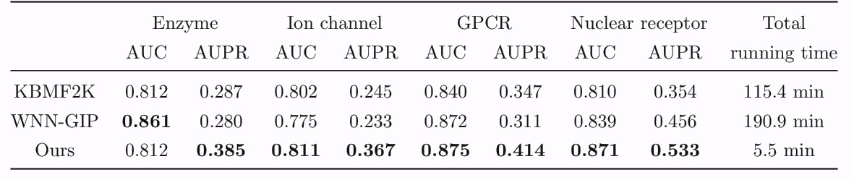
Overall performance

Slide 34
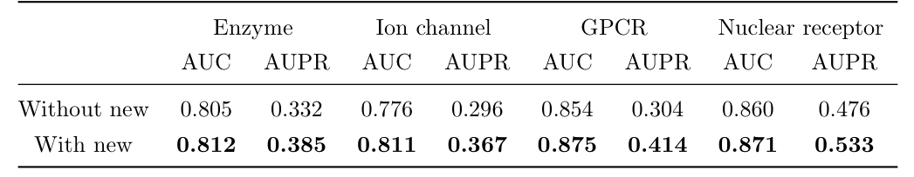
With and without new similarity measures

Slide 35
New drug, new target
Remove known interactions from the data set to create “new” drugs and targets
Consider if the removed interactions could be predicted
The mis-prediction error measures the fraction of “new” drugs with a wrong prediction
Notes:
One-error evaluates how many times the top-ranked label is not in the set of relevant labels of the instance
For each drug, we determine whether it has known interaction between its top-ranked predicted target. If there is no known interaction between the drug and its top-ranked predicted target, the prediction is considered wrong. The one-error measures the fraction of drugs with a wrong prediction.

Slide 36
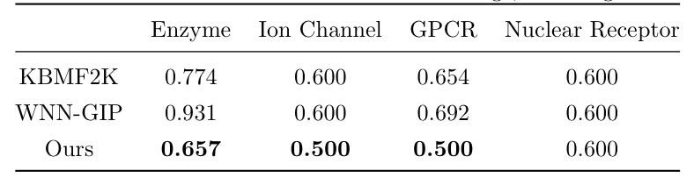
New drug, new target
The numbers are mis-prediction errors.
The smaller the mis-prediction error, the better the performance.
Notes:
One-error evaluates how many times the top-ranked label is not in the set of relevant labels of the instance
For each drug, we determine whether it has known interaction between its top-ranked predicted target. If there is no known interaction between the drug and its top-ranked predicted target, the prediction is considered wrong. The one-error measures the fraction of drugs with a wrong prediction.

Slide 37

Conclusions
Non-structural-based similarities
“Super-targets”

Slide 38
References
E. E. Bolton, Y. Wang, P. A. Thiessen et al., “PubChem: integrated platform of small molecules and biological activities,” Annual Reports in Computational Chemistry, vol. 4, pp. 217–241, 2008.
M. Hurle, L. Yang, Q. Xie et al., “Computational drug repositioning: from data to therapeutics,” Clin. Pharmacol. Ther., vol. 93, no. 4, pp. 335–341, 2013.
M. A. Yıldırım, K.-I. Goh, M. E. Cusick et al., “Drug-target network,” Nat. Biotechnol., vol. 25, no. 10, pp. 1119–1126, 2007.
F. Cheng, C. Liu, J. Jiang et al., “Prediction of drug-target interactions and drug repositioning via network-based inference,” PLoS Comput. Biol., vol. 8, no. 5, p. e1002503, 2012.
D.-S. Cao, S. Liu, Q.-S. Xu et al., “Large-scale prediction of drug–target interactions using protein sequences and drug topological structures,” Anal. Chim. Acta., vol. 752, pp. 1–10, 2012.
L. Jacob and J.-P. Vert, “Protein-ligand interaction prediction: an improved chemogenomics approach,” Bioinformatics, vol. 24, no. 19, pp. 2149–2156, 2008.
Y. Yamanishi, M. Araki, A. Gutteridge et al., “Prediction of drug–target interaction networks from the integration of chemical and genomic spaces,” Bioinformatics, vol. 24, no. 13, pp. i232–i240, 2008.
J.-P. Mei, C.-K. Kwoh, P. Yang et al., “Drug–target interaction prediction by learning from local information and neighbors,” Bioinformatics, vol. 29, no. 2, pp. 238–245, 2013.
T. van Laarhoven, S. B. Nabuurs, and E. Marchiori, “Gaussian interaction profile kernels for predicting drug–target interaction,” Bioinformatics, vol. 27, no. 21, pp. 3036–3043, 2011.
T. van Laarhoven and E. Marchiori, “Predicting drug-target interactions for new drug compounds using a weighted nearest neighbor profile,” PloS One, vol. 8, no. 6, p. e66952, 2013.
M. Gonen, “Predicting drug–target interactions from chemical and genomic kernels using Bayesian matrix factorization,” Bioinformatics, vol. 28, no. 18, pp. 2304–2310, 2012.
Y. Koren, R. Bell, and C. Volinsky, “Matrix factorization techniques for recommender systems,” Computer, vol. 42, no. 8, pp. 30–37, 2009.
M. Kanehisa and S. Goto, “KEGG: Kyoto encyclopedia of genes and genomes,” Nucleic Acids Res., vol. 28, no. 1, pp. 27–30, 2000.
“ATC structure and principles,” http://www.whocc.no/atc/structure_and_principles/, accessed: 2014-06-30.
M.-L. Zhang and Z.-H. Zhou, “ML-KNN: A lazy learning approach to multi-label learning,” Pattern Recogn., vol. 40, no. 7, pp. 2038–2048, 2007.
K. Bleakley and Y. Yamanishi, “Supervised prediction of drug–target interactions using bipartite local models,” Bioinformatics, vol. 25, no. 18, pp. 2397–2403, 2009.
M. Hattori, Y. Okuno, S. Goto et al., “Development of a chemical structure comparison method for integrated analysis of chemical and genomic information in the metabolic pathways,” J. Am. Chem. Soc., vol. 125, no. 39, pp. 11 853–11 865, 2003.
T. F. Smith and M. S. Waterman, “Identification of common molecular subsequences,” J. Mol. Biol., vol. 147, no. 1, pp. 195–197, 1981.
M. Tsuji, “Local motifs involved in the canonical structure of the ligand-binding domain in the nuclear receptor superfamily,” J. Struct. Biol., vol. 185, no. 3, pp. 355–365, 2014.
I. Letunic, T. Doerks, and P. Bork, “SMART 7: recent updates to the protein domain annotation resource,” Nucleic Acids Res., vol. 40, no. D1, pp. D302–D305, 2012.
J. Davis and M. Goadrich, “The relationship between Precision-Recall and ROC curves,” in Proceedings of the 23rd international conference on Machine learning. ACM, 2006, pp. 233–240.
F. J. Azuaje, L. Zhang, Y. Devaux et al., “Drug-target network in myocardial infarction reveals multiple side effects of unrelated drugs,” Scientific Reports, vol. 1, 2011.
G. Tsoumakas, I. Katakis, and I. Vlahavas, “Mining multi-label data,” in Data Mining and Knowledge Discovery Handbook. Springer, 2010, pp. 667–685.

Slide 39
Image sources
Shen Nong. http://upload.wikimedia.org/wikipedia/commons/c/c5/Shennong3.jpg
Herb. https://c2.staticflickr.com/6/5046/5366857952_6c04ec9b35_b.jpg
Zyprexa. http://da.wikipedia.org/wiki/Olanzapin#mediaviewer/File:Zyprexa.PNG
Schizophrenia patient artwork. http://upload.wikimedia.org/wikipedia/commons/b/b2/Cloth_embroidered_by_a_schizophrenia_sufferer.jpg
D2R. http://en.wikipedia.org/wiki/Dopamine_receptor_D2#mediaviewer/File:Protein_DRD2_PDB_1I15.png
Yellow and blue pills. http://commons.wikimedia.org/wiki/File:Pharmaceuticals.jpg
Aspirin 2D structure. http://commons.wikimedia.org/wiki/File:Aspirin-skeletal.png
Prozac 2D structure. http://commons.wikimedia.org/wiki/File:Fluoxetine_structure.svg
FOXP2 structure. http://en.wikipedia.org/wiki/FOXP2
Protein structure #1. http://upload.wikimedia.org/wikipedia/commons/8/86/Argonne's_Midwest_Center_for_Structural_Genomics_deposits_1,000th_protein_structure.jpg
Protein structure #2. http://upload.wikimedia.org/wikipedia/commons/8/86/Argonne's_Midwest_Center_for_Structural_Genomics_deposits_1,000th_protein_structure.jpg
Tablets. http://pixabay.com/en/medications-cure-tablets-pharmacy-342462/
Doxycycline. http://en.wikipedia.org/wiki/Doxycycline#mediaviewer/File:Doxycycline_100mg_capsules.jpg
Orange tablets in yellow cup. http://pixabay.com/en/tablets-pills-medicine-disease-193666/
Furosemide. http://upload.wikimedia.org/wikipedia/commons/thumb/5/51/Furosemide_(1).JPG/768px-Furosemide_(1).JPG
My neighbor Totoro. http://helixaspersa.deviantart.com/art/My-Neighbor-Totoro-in-Autumm-137190257
* All the images used are labeled for non-commercial reuse by Google image search.

Slide 40
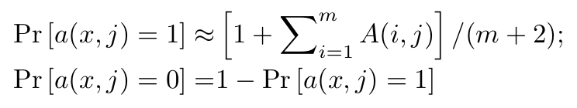
Supplementary #1
Estimating Pr(A) and Pr(A^{C})
Event A: (New) drug d interacts with target t
Event B: c drugs in the set of d’s K nearest neighbors interacts with target t

Slide 41
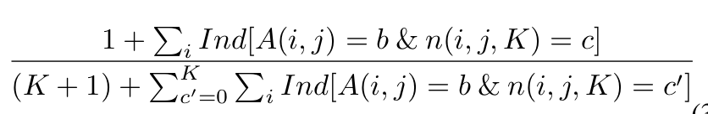
Supplementary #1
Estimating Pr(B|A) and Pr(B|A^{C})
Event A: (New) drug d interacts with target t
Event B: c drugs in the set of d’s K nearest neighbors interacts with target t

Slide 42
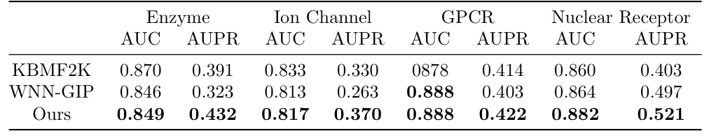
Supplementary #2
All the methods with new similarity measures

